Slide 1


Personal Expense Tracker
and Planner
group work

Slide 2

overview
This documentation explores :
undersand the meaning of personal expense tracker
the importance personal expense tracker
challenges
types
features
and best practices related to expense tracking.

Slide 3

undersand the meaning of personal
expense tracker
Managing personal finances is essential in today's fast-paced world.
A Personal Expense Tracker serves as a tool to monitor and manage individual spending,
ultimately promoting financial stability,and manage budgets in a streamlined and user-friendly interface.

Slide 4
the importance personal expense tracker
Tracking personal expenses is vital for maintaining financial health. It allows individuals to:
Goal 1
Goal 2
Understand where their money goes.
Recognize and evaluate spending patterns.
Goal 3
Goal 4
Make informed financial decisions.
Avoid unnecessary expenses and save for future needs.

Slide 5

Common Challenges
Lack of Time: Daily life can make consistent tracking difficult.
Forgetfulness: Small transactions are often missed.
Unawareness: Many don’t know where to begin or how to track
efficiently.

Slide 6

Reminders for Myself
I will be specific with my goals.
I will measure my success by creating practical milestones.
I will ensure my milestones and goals are achievable with the timeline I'll set.
to Be Smart
I will work on goals that are relevant and align with my values and core beliefs.
I will set a workable timeline so I know when to check in with myself.
With My Goals

Slide 7
Savings Tracker
04
Month | Income | Budget for Expenses | Balance
January | $25,000 | $10,000 | $15,000
February | $25,000 | $10,000 | $15,000
March
April
May
June
Total Balance
of Savings:
$30,000

Slide 8

My Kinds of Expenses
06
Fixed
Variable
Intermittent
Discretionary
Expenses that remain the same every month
Expenses that vary from every month
Expenses that occur at various times only
Expenses to reward ourselves with
Rent
Mortgage
Car payment
TV and cable
Communication
Electricity
Water
Gas
Food
Clothing
Tuition
Insurance
Home repairs
Car repairs
Shopping
Gifts
Food delivery

Slide 9
Expenses Tracker
07
Date | Type of Expense | Description | Amount | Balance
January 12 |  | Rent | $2,500 | $12,500
Month:
January
Budget:
$15,000
Type of Expense:
Fixed
Variable
Intermittent
Discretionary

Slide 10
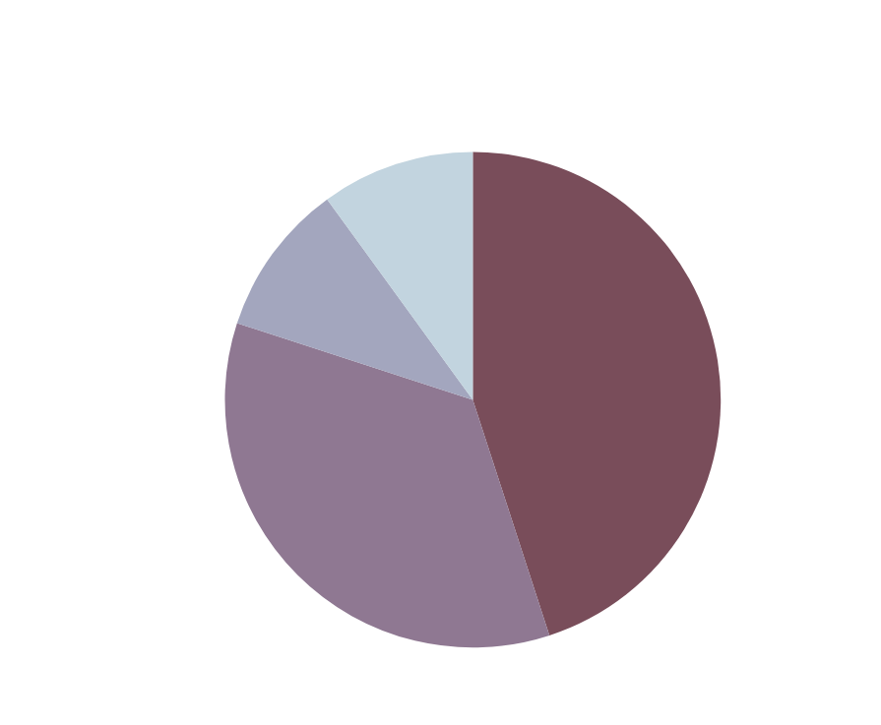
Summary of My Expenses
09

Slide 11
Create a Realistic Budget
Set a monthly or weekly budget based on your income and fixed expenses
10
What Can I Do to Improve My Spending Habits?
Differentiate Needs vs Wants
Ask yourself: “Do I really need this?”
Avoid Temptations
Unsubscribe from marketing emails.
Remove shopping apps you don't need

Slide 12



Slide 13
group members:
Your paragraph text

